Slide 1
Meeting #5
Genome assembly (applications)
Genome annotation
Alignment

Slide 2
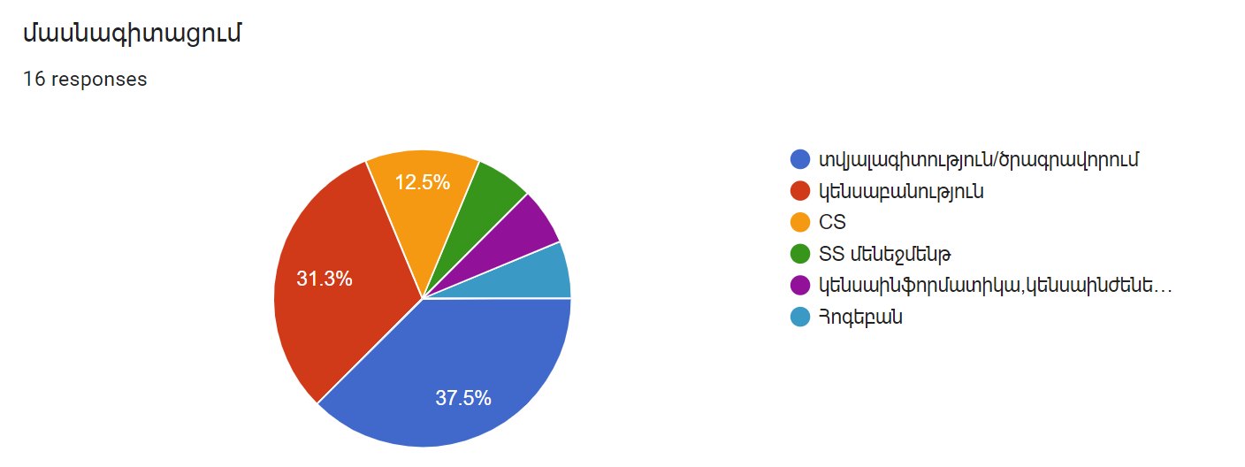
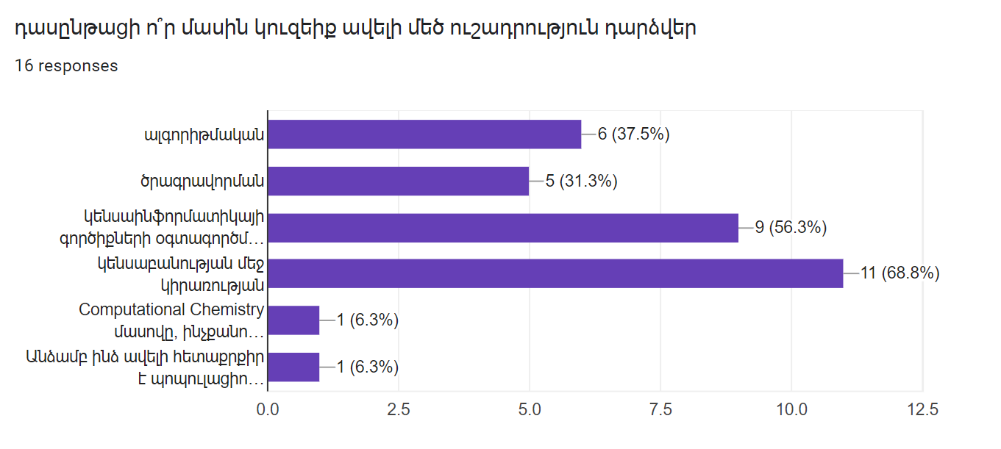
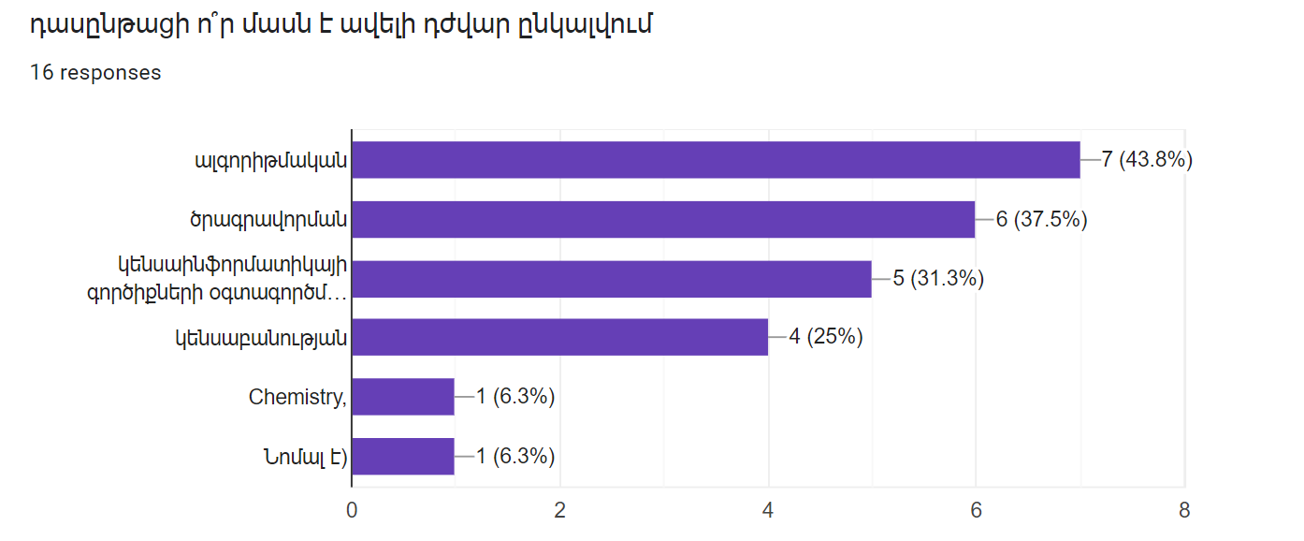

Slide 3
Genome assembly
The present and future of de novo whole-genome assembly
Jang-il Sohn and Jin-Wu Nam
Briefings in Bioinformatics, 19(1), 2018, 23–40
doi: 10.1093/bib/bbw096

Slide 4
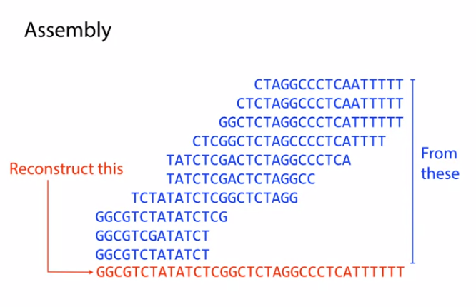
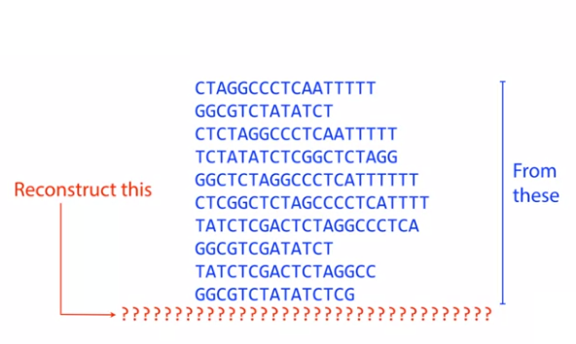
The assembly problem

Slide 5
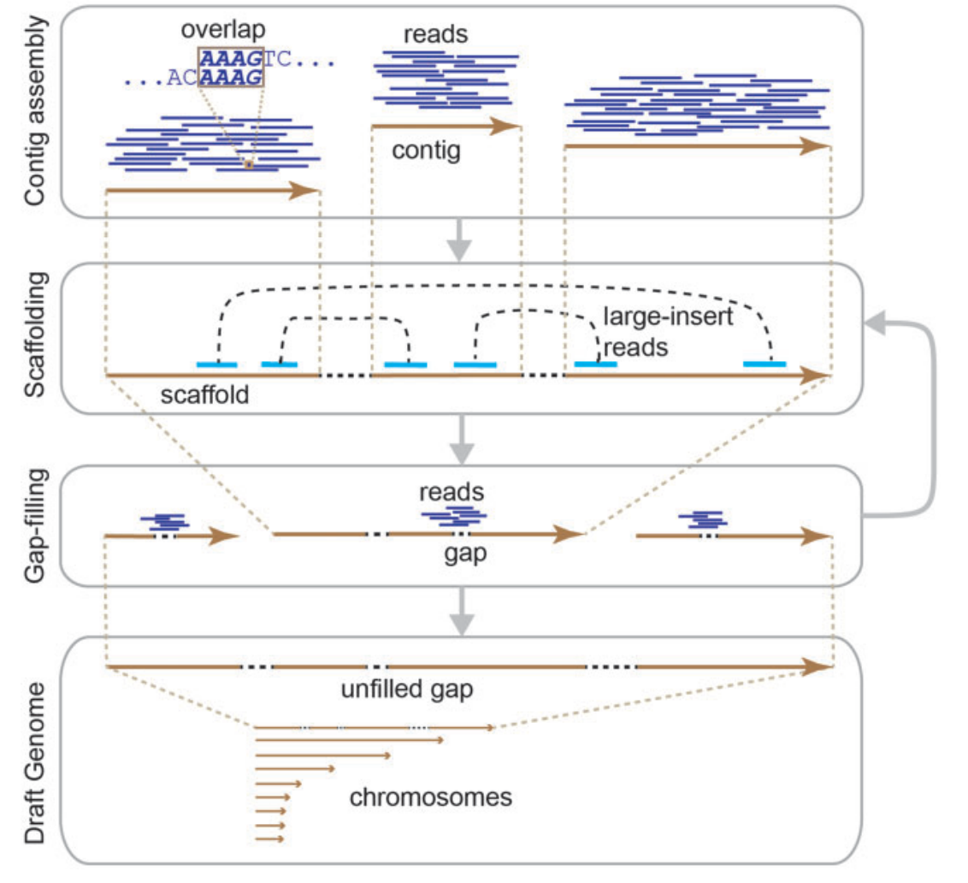
General workflow of genome assembly
General workflow of the de novo assembly of a whole genome.
By overlapping reads, contigs are assembled from short reads before scaffolding by large-insert reads, and the remaining gaps are filled. The scaffolding and gap-filling steps can be iteratively performed until no contigs are scaffolded or no additional gaps are resolved before completion. Through this procedure, a draft genome consisting of chromosomes is built. Some unfilled gaps may remain in the draft genome.
Contig = consensus sequence without gaps
Scaffolding = contigs are connected by large-insert paired reads or large DNA fragments.
If gaps remain between contigs, those are filled with other independent reads.
The scaffolding may then repeat iteratively along with gap filling.

Slide 6
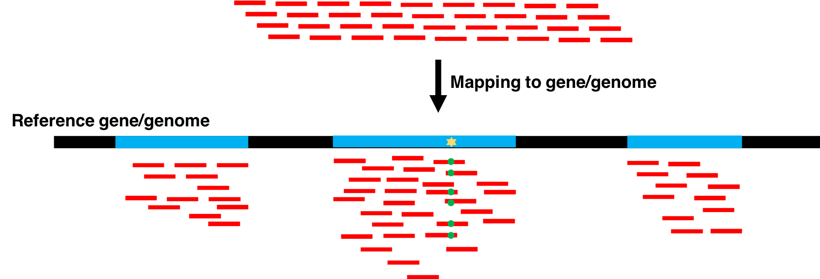
Why is reference genome assembly useful?
Describe, classify and identify organisms.
Alignment: find genomic variation between individuals by short read DNA sequencing
Alignment: find gene expression patterns by RNA sequencing read alignment
Local alignment search: find which organism the sequence belongs to.
Global alignment: find evoluationary relationship between organisms (phylogenetics).

Slide 7
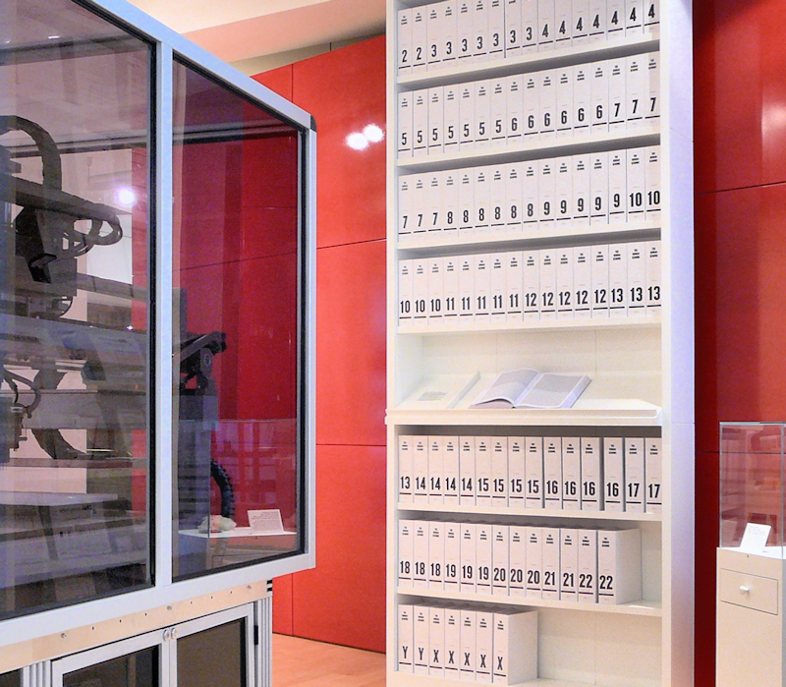
The first draft of the human genome
the 'Medicine Now' room at the Wellcome Collection, London. The 3.4 billion units of DNA code are transcribed into more than a hundred volumes, each a thousand pages long, in type so small as to be barely legible.

Slide 8
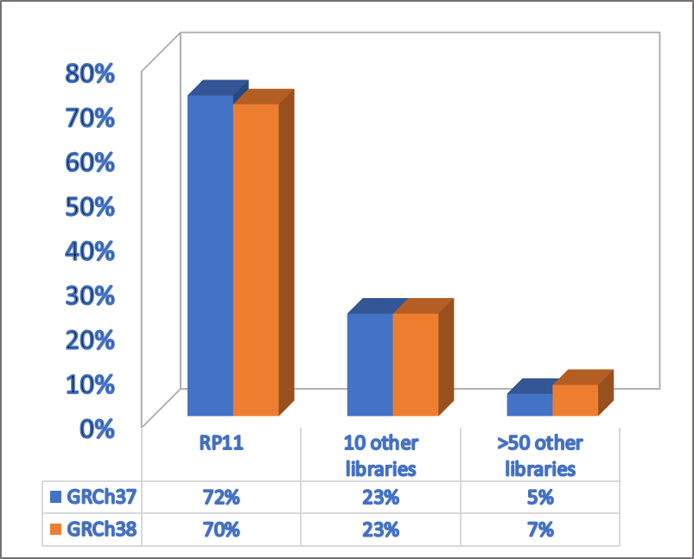
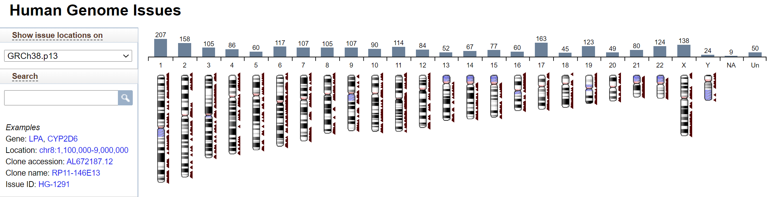
Current status of human genome assembly
With >95% of the chromosome total sequence and 98% of noncentromeric sequence derived from genomic clone components, the GRCh38 reference assembly chromosomes continue to provide a mosaic haploid representation of the human genome, rather than a consensus haploid representation. The sequence contribution from RP11, an anonymous male donor of likely African-European admixed ancestry, remains dominant (∼70%), but has decreased by ∼1.5% relative to the previous assembly version
10.1101/gr.213611.116
https://www.ncbi.nlm.nih.gov/grc/human

Slide 9
A unified catalog of 204,938 reference genomes from the human gut microbiome
Nature Biotechnology (2020)
DOI: 10.1038/s41587-020-0603-3

Slide 10
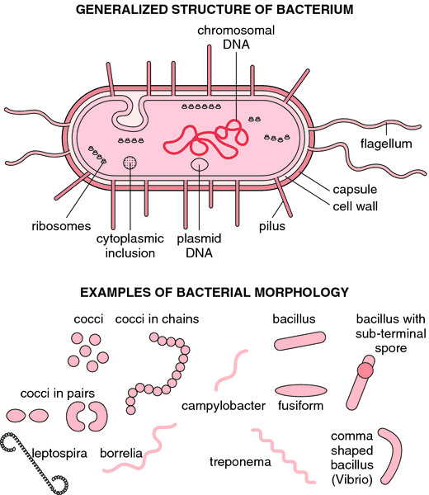
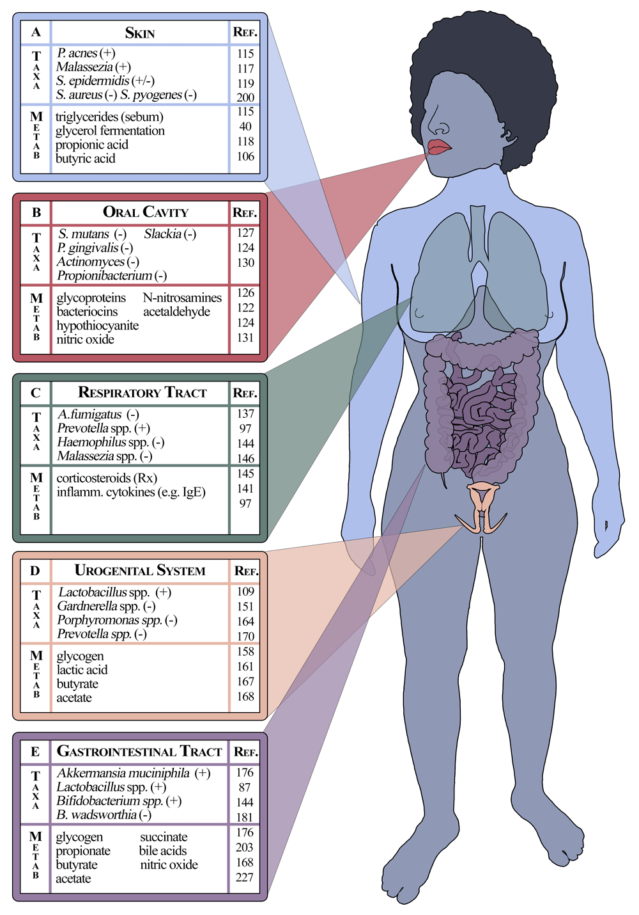
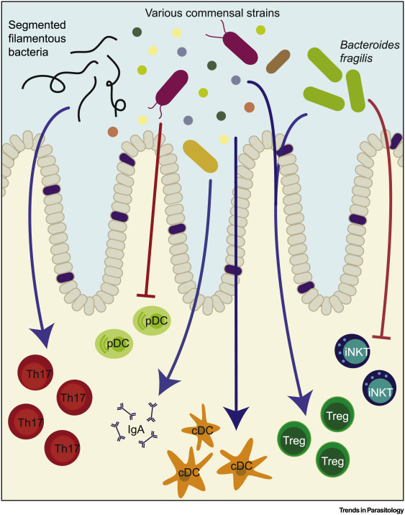
The human microbiome
https://doi.org/10.1016/j.pt.2019.07.015
Bacterial structure and morphology. From Hart and Shears, 1997.
The revised ratio of human cells versus bacterial 1:1
https://doi.org/10.1371/journal.pbio.1002533

Slide 11
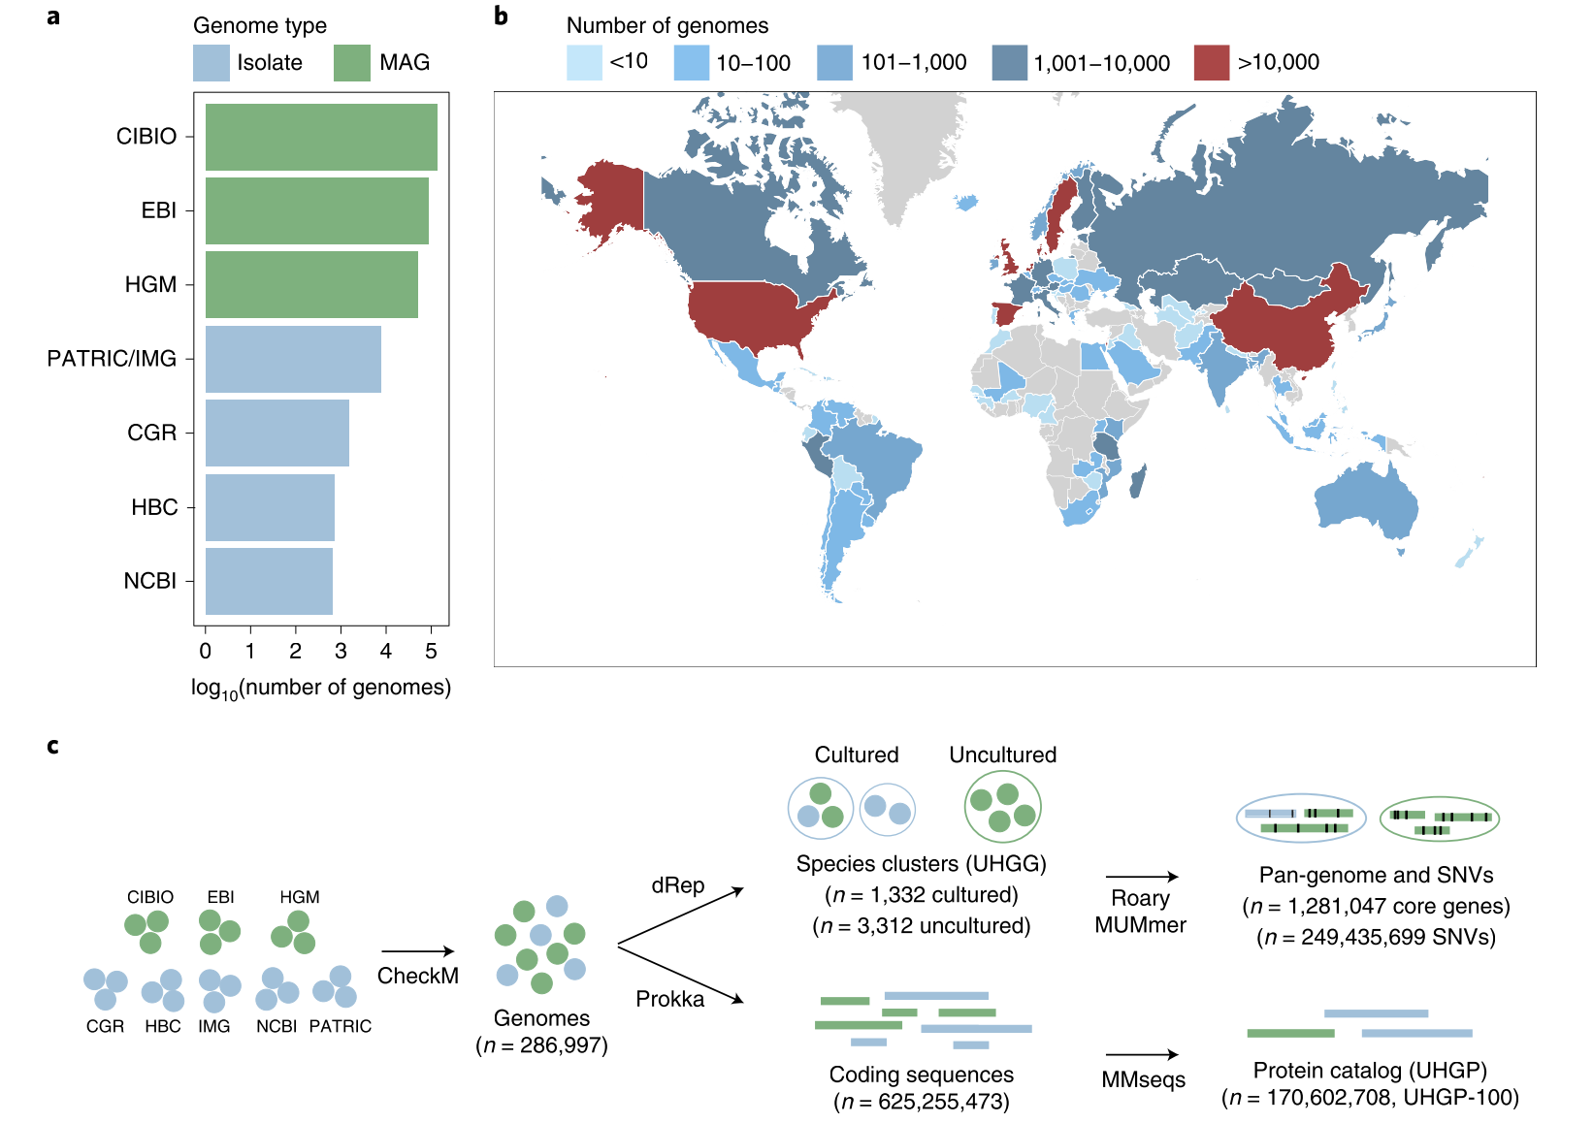
The unified sequence catalog of the human gut microbiome
a, Number of gut genomes for each study set used to generate the sequence catalogs, colored according to whether they represent isolate genomes or metagenome-assembled genomes (MAG)s. b, Geographic distribution of the number of genomes retrieved per country.
c, Overview of the methods used to generate the genome (UHGG, Unified Human Gastrointestinal Genome) and protein sequence (UHGP) catalogs. Genomes retrieved from public datasets first underwent quality control by CheckM. Filtered genomes were clustered at an estimated species level (95% ANI), and their intraspecies diversity was assessed (genes from conspecific genomes were clustered at 90% protein identity). In parallel, a nonredundant protein catalog was generated from all coding sequences of the 286,997 genomes at 100% (UHGP-100, n = 170,602,708), 95% (UHGP-95, n = 20,239,340), 90% (UHGP-90, n = 13,907,849) and 50% (UHGP-50, n = 4,735,546) protein identity.
4,644 inferred prokaryotic species
573 high quality genomes
60% could not be assigned to existing species
71% lack cultured representative

Slide 12
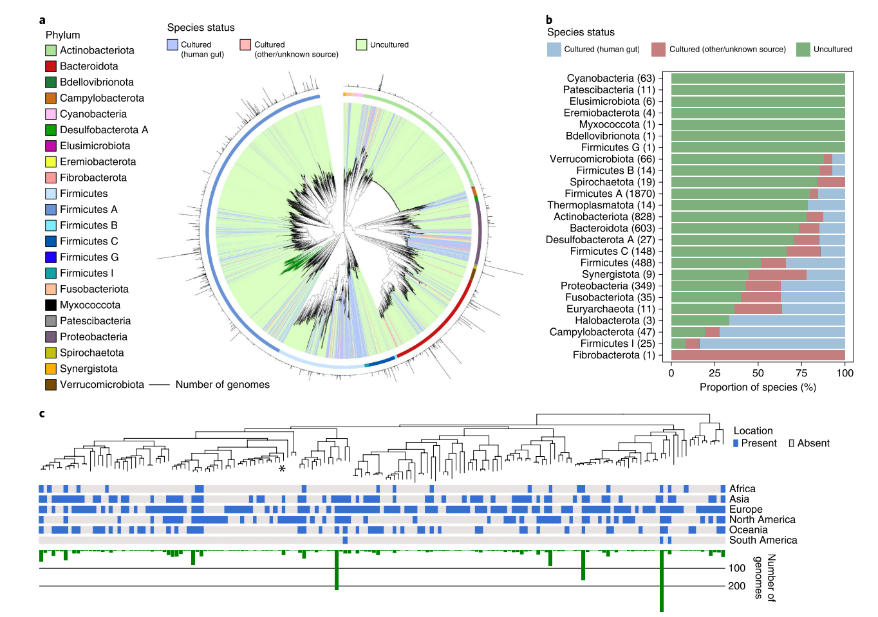
Uncultured species are predominant among human gut phyla.
a, Maximum-likelihood phylogenetic tree of the 4,616 bacterial species detected in the human gut. Clades are colored by the cultured status of species, with outer circles depicting the GTDB phylum annotation. Bar graphs in the outermost layer indicate the number of genomes from each species. The order Comantemales ord. nov. is highlighted with dark green branches.
b, Proportion of species within the 25 prokaryotic phyla detected according to cultured status. Numbers in parentheses represent the total number of species in the corresponding phylum.
c, Phylogenetic tree of species belonging to the order Comantemales ord. nov. (phylum Firmicutes A), the largest phylogenetic group exclusively represented by uncultured species. The geographic distribution of each species and the number of genomes recovered are represented below the tree. The species previously classified as Candidatus ‘Borkfalki ceftriaxensis’ is indicated with an asterisk.

Slide 13
Problems from ISBM 2020
the 28th Annual Conference on Intelligent Systems for Molecular Biology, July 13–16, 2020
https://academic.oup.com/bioinformatics/issue/36/Supplement_1

Slide 14
metagenomics binning
MetaBCC-LR: metagenomics binning by coverage and composition for long reads https://doi.org/10.1093/bioinformatics/btaa441
Reference-based binning
Reference-free binning

Slide 15
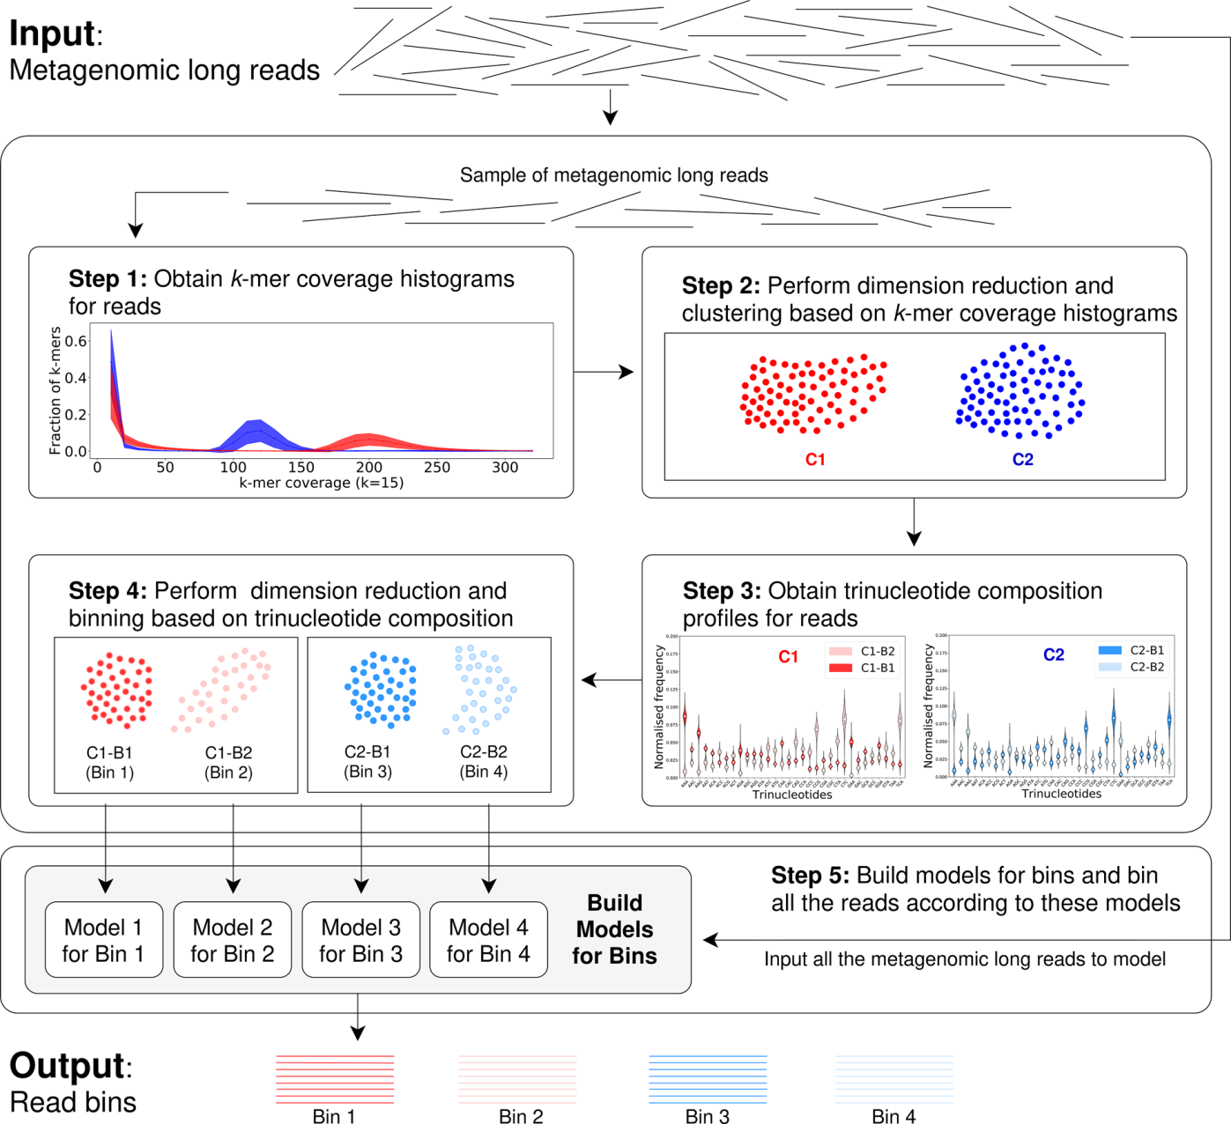
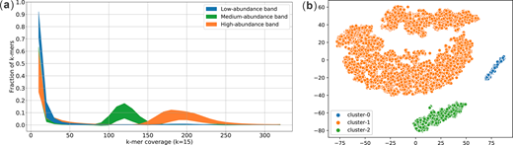
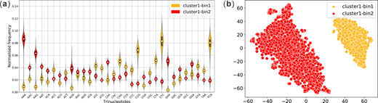
MetaBCC-LR: metagenomics binning by coverage and composition for long reads https://doi.org/10.1093/bioinformatics/btaa441
design MetaBCC-LR, a scalable reference-free binning tool to bin metagenomic long reads. MetaBCC-LR uses discriminatory features, that capture species abundance and composition information, for finding the number of bins and developing a statistical model for each bin. This is accomplished by using just a sample of the input reads, enabling MetaBCC-LR to efficiently handle large datasets.
Typically, assemblers erroneously assume uniform coverages and low abundance species tend to be ignored—that can be ameliorated by binning reads before assembly.

Slide 16
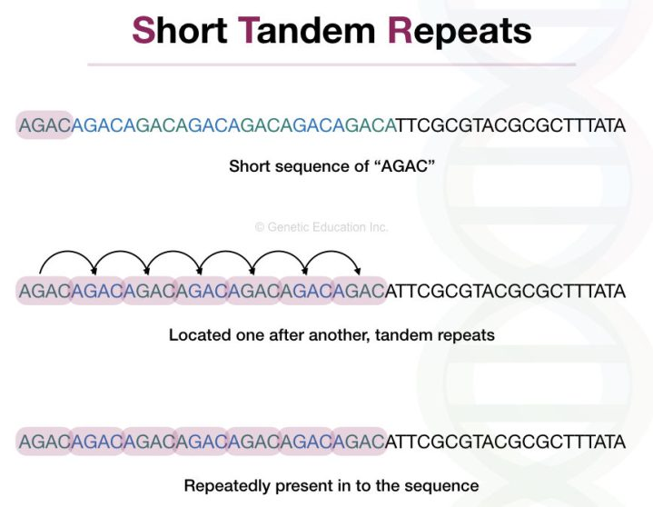
TandemTools: mapping long reads and assessing/improving assembly quality in extra-long tandem repeats https://doi.org/10.1093/bioinformatics/btaa440
Tandem repeats are formed by multiple consecutive nearly identical sequences that are often generated by unequal crossover.
We distinguish between extensively studied short tandem repeats and extra-long tandem repeats (ETRs) that range in length from tens of thousands to millions of nucleotides. Centromeric and pericentromeric regions contain some of the longest ETRs that account for ∼3% of the human genome and span megabase-long regions. Centromeres and pericentromeres represent the ‘dark matter’ of the human genome that evaded all attempts to sequence until recently and are the largest gaps in the reference human genome. The goal of the telomere-to-telomere (T2T) consortium is to generate a complete assembly of the human genome, including all centromeres and pericentromeres. This effort recently resulted in assemblies of chromosomes X and Y but centromeres in other chromosomes are waiting to be assembled.
Problems:
Repeats
Absence of ground truth benchmarking.

Slide 17
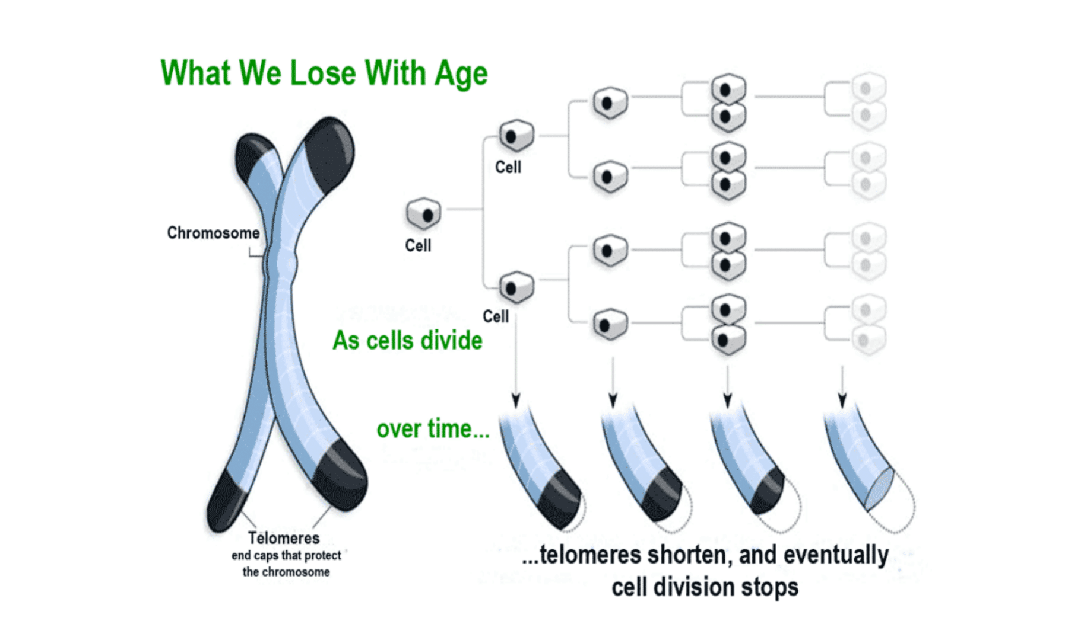
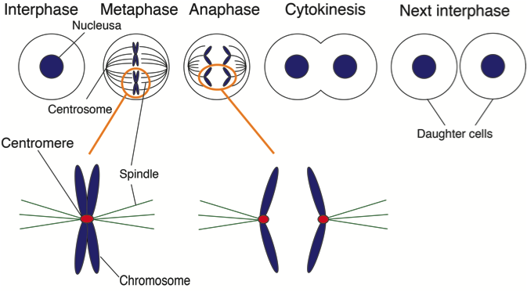
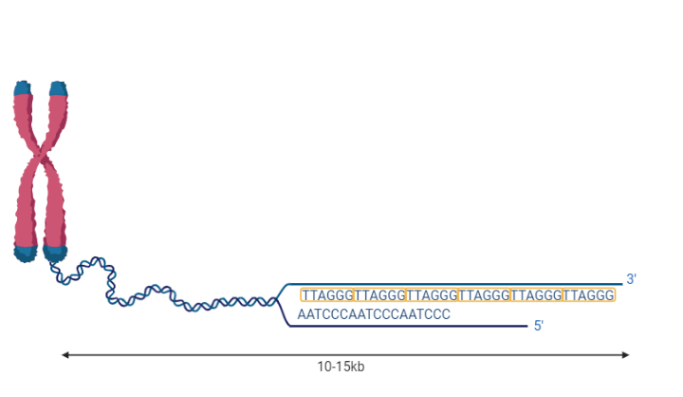
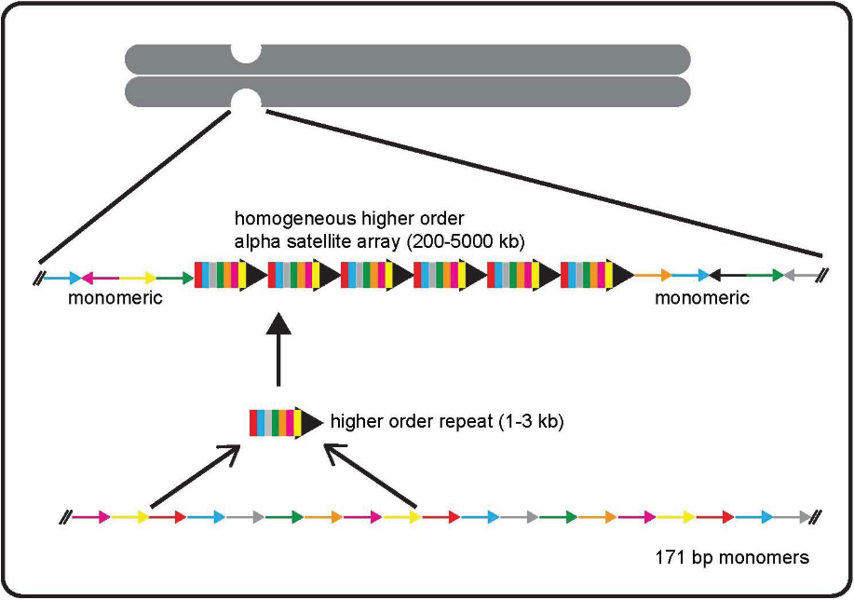
Repetitive regions in the linear chromosomes
Telomeres
Centromeres

Slide 18
TandemTools: mapping long reads and assessing/improving assembly quality in extra-long tandem repeats https://doi.org/10.1093/bioinformatics/btaa440
Tandem repeats are formed by multiple consecutive nearly identical sequences that are often generated by unequal crossover.
We distinguish between extensively studied short tandem repeats and extra-long tandem repeats (ETRs) that range in length from tens of thousands to millions of nucleotides. Centromeric and pericentromeric regions contain some of the longest ETRs that account for ∼3% of the human genome and span megabase-long regions. Centromeres and pericentromeres represent the ‘dark matter’ of the human genome that evaded all attempts to sequence until recently and are the largest gaps in the reference human genome. The goal of the telomere-to-telomere (T2T) consortium is to generate a complete assembly of the human genome, including all centromeres and pericentromeres. This effort recently resulted in assemblies of chromosomes X and Y but centromeres in other chromosomes are waiting to be assembled.
Problems:
Repeats
Absence of ground truth benchmarking.

Slide 19
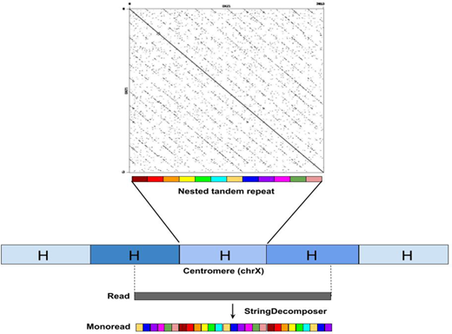
The string decomposition problem and its applications to centromere analysis and assembly https://doi.org/10.1093/bioinformatics/btaa454
Recent attempts to assemble extra-long tandem repeats (such as centromeres) faced the challenge of translating long error-prone reads from the nucleotide alphabet into the alphabet of repeat units. Human centromeres represent a particularly complex type of high-order repeats (HORs) formed by chromosome-specific monomers. Given a set of all human monomers, translating a read from a centromere into the monomer alphabet is modeled as the String Decomposition Problem. The accurate translation of reads into the monomer alphabet turns the notoriously difficult problem of assembling centromeres from reads (in the nucleotide alphabet) into a more tractable problem of assembling centromeres from translated reads.
We describe a StringDecomposer (SD) algorithm for solving this problem

Slide 20
Thank you
Next topics:
Alignment
variant calling

